Slide 1
Cloud Deployment Models
Bachelor of Engineering - Computer Science & Engineering
Cloud Computing (CC)(23CS009)
Department of Computer Science & Engineering
Chitkara University Institute of Engineering and Technology, Chitkara University, Punjab, India

Slide 2
Contents
Introduction to Cloud Deployment Models
Types of Cloud Deployment Models: Public, Private, Hybrid and Community
Comparison: Public vs. Private vs. Hybrid

Slide 3
Cloud Deployment Models
Cloud deployment models define how cloud services are deployed, managed, and accessed based on organizational needs and infrastructure ownership.
The four main models are Public Cloud, Private Cloud, Hybrid Cloud, and Community Cloud.

Slide 4
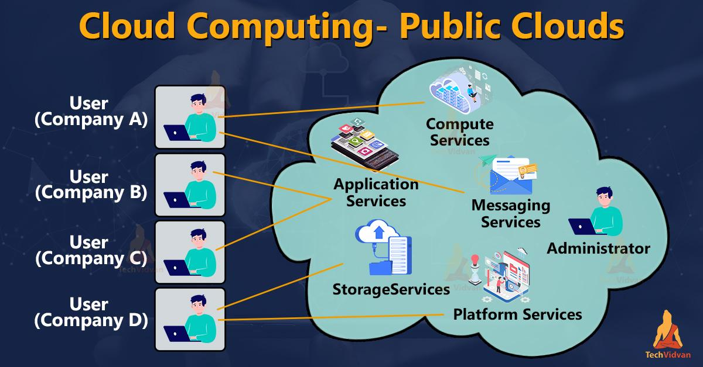
Types of Cloud Deployment Models: Public Cloud
Public Cloud
The public cloud is a cloud computing model where services and infrastructure are hosted by third-party providers and shared among multiple organizations.
Public cloud services are accessed over the internet and offer scalability, cost-efficiency, and minimal management.

Slide 5
Types of Cloud Deployment Models: Public Cloud
Characteristics:
Shared resources across multiple tenants.
Accessible over the internet.
Providers manage infrastructure, maintenance, and upgrades.
Pay-as-you-go pricing.

Slide 6
Types of Cloud Deployment Models: Public Cloud
Examples:
Netflix: Uses Amazon Web Services (AWS) for streaming, enabling scalability during peak hours.
Adobe Creative Cloud: Runs on Microsoft Azure, providing design software globally with high availability.
Spotify: Leverages Google Cloud Platform (GCP) for data analytics and real-time processing of user preferences.
Dropbox: Migrated from private infrastructure to AWS for cost savings and enhanced collaboration features.

Slide 7
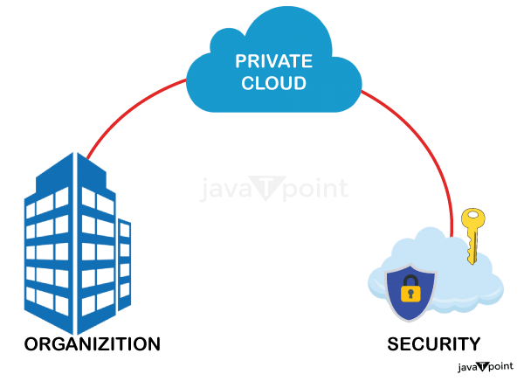
Types of Cloud Deployment Models: Private Cloud
Private Cloud
The private cloud is dedicated to a single organization, offering enhanced security, control, and customization.
It can be hosted on-premises or by third-party providers.

Slide 8
Types of Cloud Deployment Models: Private Cloud
Characteristics:
Exclusive use by one organization.
Customizable architecture tailored to organizational needs.
Enhanced privacy and compliance.
High initial costs but reduced ongoing risks.

Slide 9
Types of Cloud Deployment Models: Private Cloud
Examples:
Walmart: Operates a private cloud using OpenStack for internal operations and inventory management.
Capital One: Uses VMware-based private cloud infrastructure for secure and compliant financial services.
NASA: Developed its private cloud called Nebula to support research data and internal projects.
BMW: Runs its applications on a private cloud for production and supply chain optimization.

Slide 10
Types of Cloud Deployment Models: Hybrid Cloud
Hybrid Cloud
The hybrid cloud integrates public and private clouds, allowing organizations to use both depending on their needs.
For example, sensitive data can reside in a private cloud, while public cloud services handle high-volume workloads.

Slide 11
Types of Cloud Deployment Models: Hybrid Cloud
Characteristics:
Combines public and private cloud capabilities.
Provides scalability while retaining data control.
Complex setup and management.
Ideal for dynamic or unpredictable workloads.

Slide 12
Types of Cloud Deployment Models: Hybrid Cloud
Examples:
Johnson Controls: Uses Microsoft Azure Hybrid Cloud for IoT solutions, blending on-premises control with cloud scalability.
Philips Healthcare: Employs AWS Outposts for a hybrid cloud setup to process medical imaging data securely.
HSBC: Uses Google Anthos to migrate workloads between on-premises systems and public cloud environments.
General Electric (GE): Combines private cloud systems with AWS to support industrial IoT and analytics.

Slide 13
Types of Cloud Deployment Models: Community Cloud
Community Cloud
A community cloud is a shared infrastructure tailored to the needs of a specific group of organizations with common objectives, such as compliance or collaborative projects.

Slide 14
Types of Cloud Deployment Models: Community Cloud
Characteristics:
Shared by organizations with similar requirements.
Cost-effective through shared resources.
Focus on compliance and security for specific industries.
Limited scalability compared to public clouds.

Slide 15
Types of Cloud Deployment Models: Community Cloud
Examples:
G-Cloud UK: A cloud framework for public sector organizations in the UK to access shared services securely.
NASA Nebula: A community cloud developed for U.S. federal agencies to store and share research data.
Healthcare Community Cloud: Used by hospitals for secure patient data sharing and collaborative research.
European Cloud Infrastructure (GAIA-X): Designed to create a community cloud for European businesses, focusing on sovereignty and data privacy.

Slide 16
Selection of Cloud Deployment Model
As Per Studies Cloud Deployment Model can be Chosen Based on Factors Such as:
Compliance Requirements: Private or community clouds for sensitive data.
Budget Constraints: Public clouds for startups and small businesses.
Scalability Needs: Hybrid or public clouds for dynamic workloads.
Data Control: Private clouds for maximum security and customization.

Slide 17
Comparison of Deployment Models
Model | Ownership | Scalability | Security | Cost | Examples
Public Cloud | Third-party | High | Moderate | Pay-as-you-go | AWS, Azure, GCP, Dropbox
Private Cloud | Single organization | Moderate to high | High | High upfront costs | Walmart, NASA, BMW
Hybrid Cloud | Mix of public/ private | High | High | Depends on usage | HSBC, Philips, Johnson Controls
Community Cloud | Shared organizations | Moderate | High | Shared costs | NASA Nebula, G-Cloud UK, GAIA-X

Slide 18


